Slide 1

Historical Monuments
Created By
Adil Ahmed
Abdul Basit Khan
Arbaz Abid
Faculty
Sir Munif Ali

Slide 2
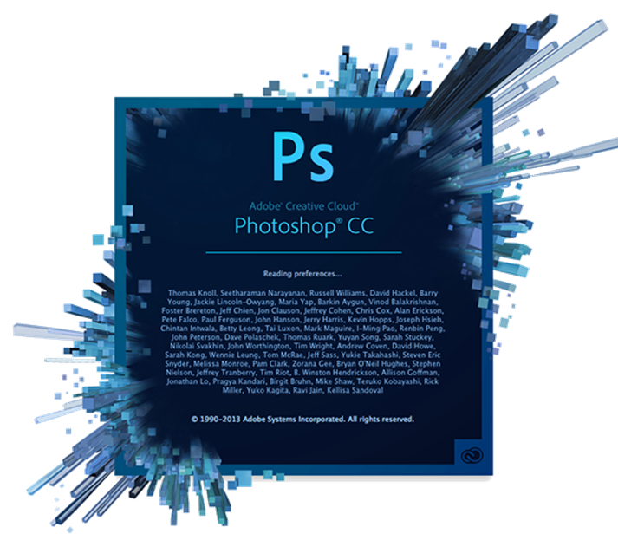

Software That Is Use In Website
Brackets created by Adobe Systems
Adobe Photoshop created by Adobe Systems.

Slide 3
Requirement Specification:
Logo.
Slider (different images of Monuments).
Navigate link through any zone (East, West, North, South).
Wonders.
History regarding places.
Gallery section.
Feedback and Queries form.
About Us and Contact Us form.
Site Map.
Download attribute.

Slide 4

Logo
Our logo: Triple A Travels & Tourism.
Triple A: Adil Ahmed, Abdul Basit, Arbaz Abid

Slide 5
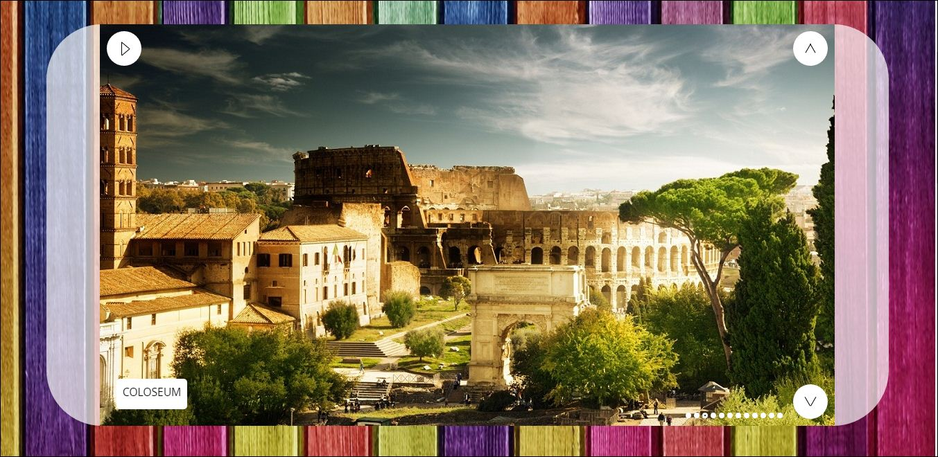
Slider
Slider is created with the help of Wow Slider.
Pictures of different Monuments and Wonders.

Slide 6
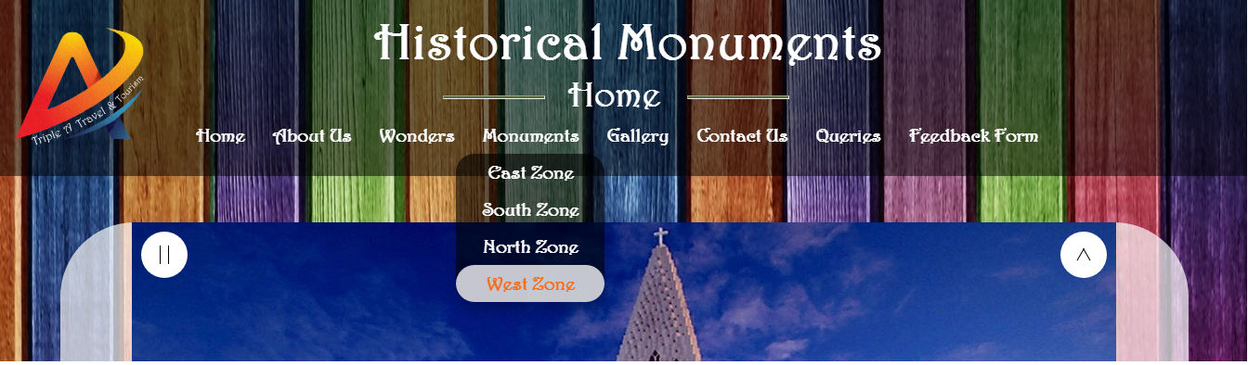
Navigate Through Zone
Monuments were categorized by zone wise (East, West, North, South).

Slide 7
Wonders
Taj Mahal.
Chichen Itza.
Christ the Redeemer.
Great Pyramid of Giza.
Great Wall of China.
Machu Picchu.
Colosseum.
Petra.

Slide 8
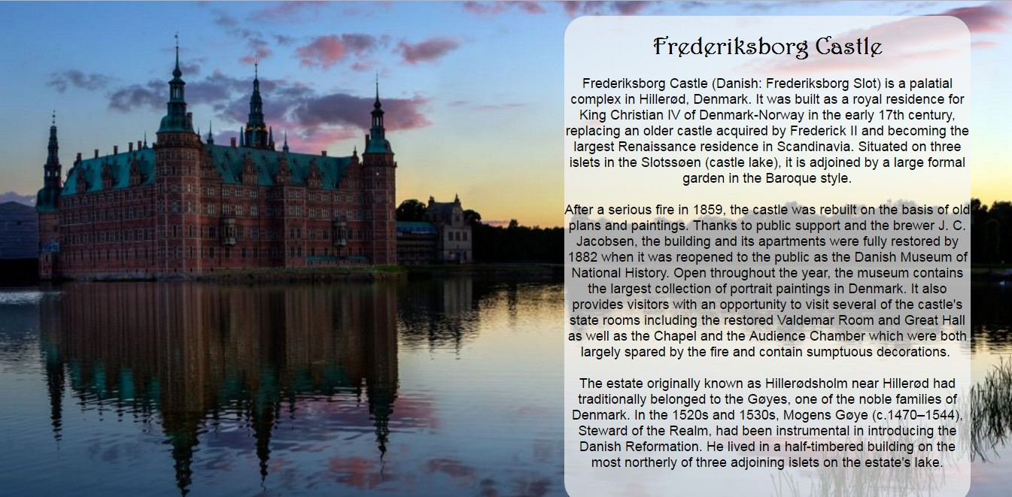
History
History related to Monuments.
All information are collected from Wikipedia.

Slide 9
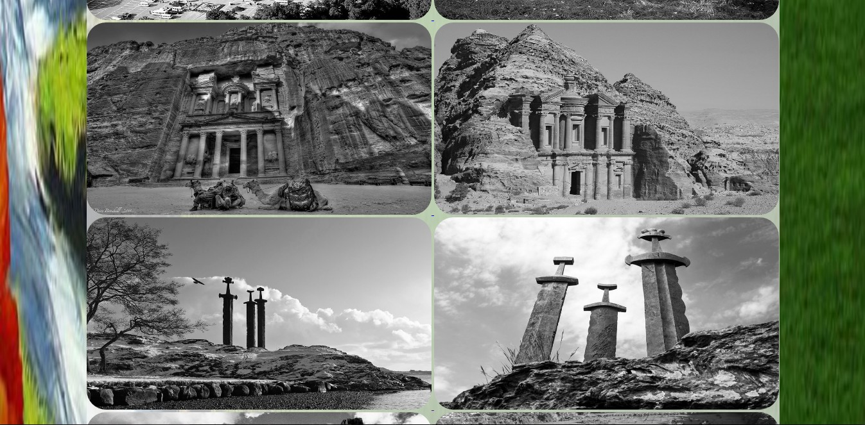
Gallery Section
All images are high resolution .
More than 30 images are added in this section.

Slide 10
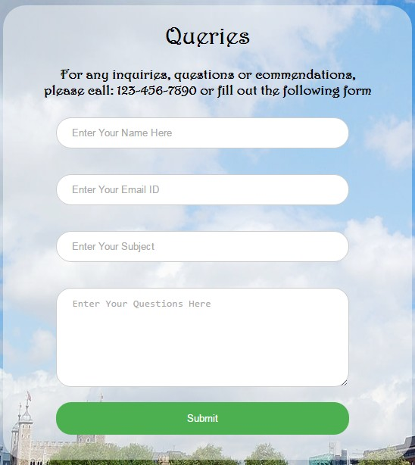
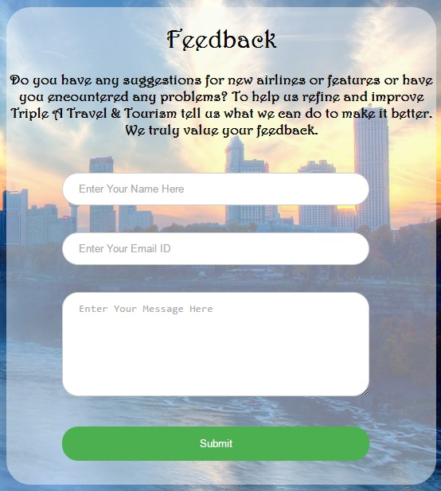
Feedback & Queries Form
Feedback and Queries form link are added in the navigation bar.
REQUIRED attribute are use in the forms.

Slide 11
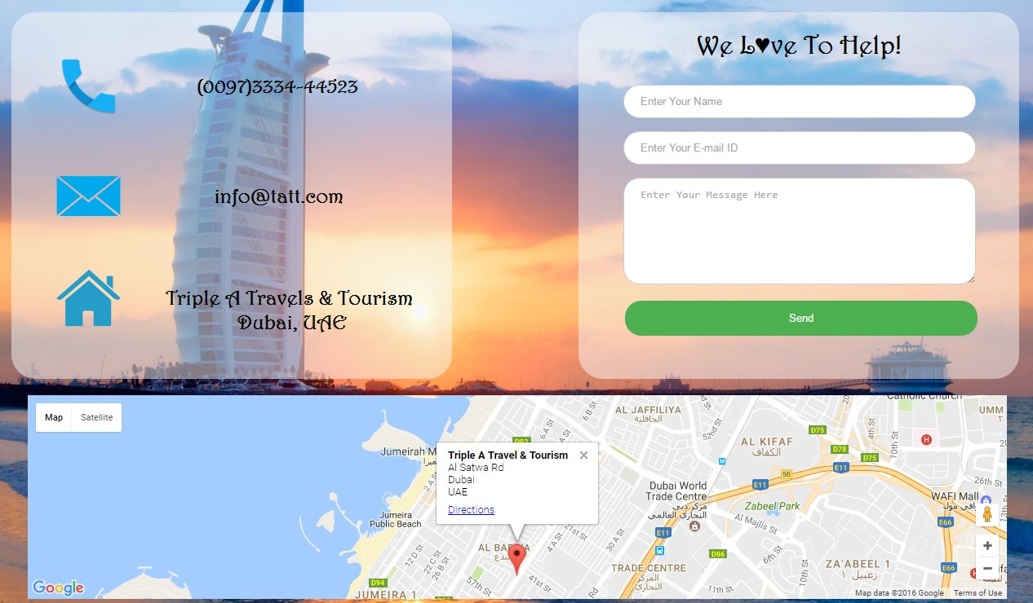
Contact Us Form
Link of contact us form are add in the navigation bar.
Google Maps Embed API.

Slide 12
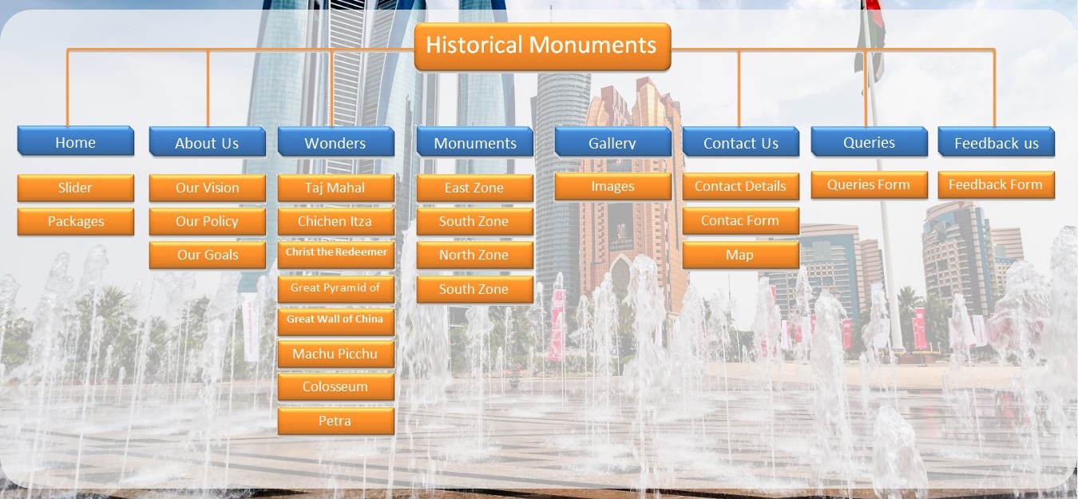
Sitemap
Sitemap is created with the help of MS Word.
Link of site map is in the footer.

Slide 13

Download Attribute
Download attribute are added in the href .
Detailed history can be download through this link as .docx

Slide 14
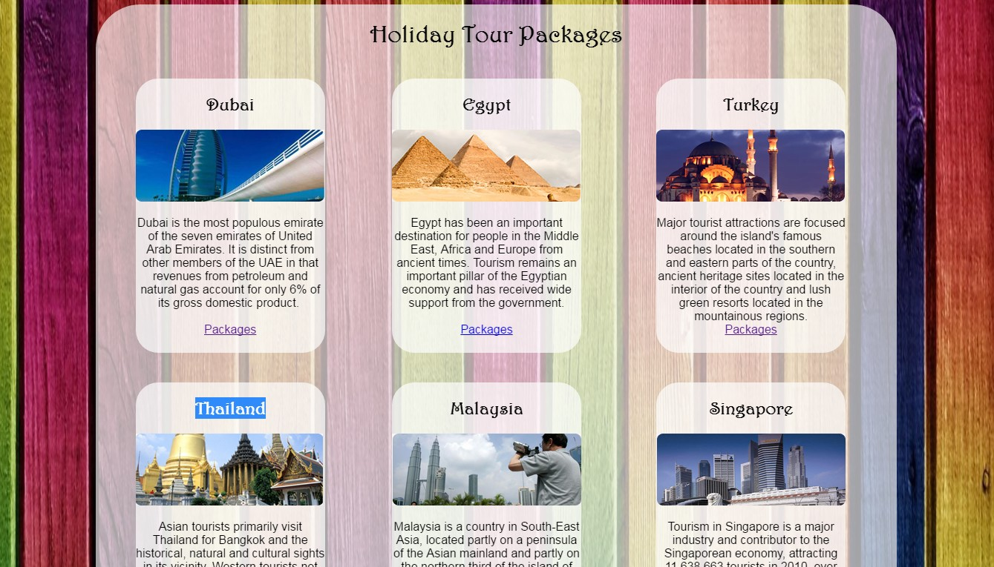
Holiday packages
For the tourism they are many packages included across the world.
Countries like Dubai, Egypt, Turkey, Thailand and etc.

Slide 15

Footer
Footer contains logo, social networking sites links like Facebook, Twitter, Gmail and YouTube.
Copyright and sitemap links also included

Slide 16

Questions and Answers

Slide 17


